Slide 1
CIS 4930/6930-002 Data Visualization
TASKS & INTERACTION
Paul Rosen
Assistant Professor
University of South Florida
slides credits Miriah Meyer (U of Utah)

Slide 2
Let’s Critique Some More Visualizations!

Slide 3
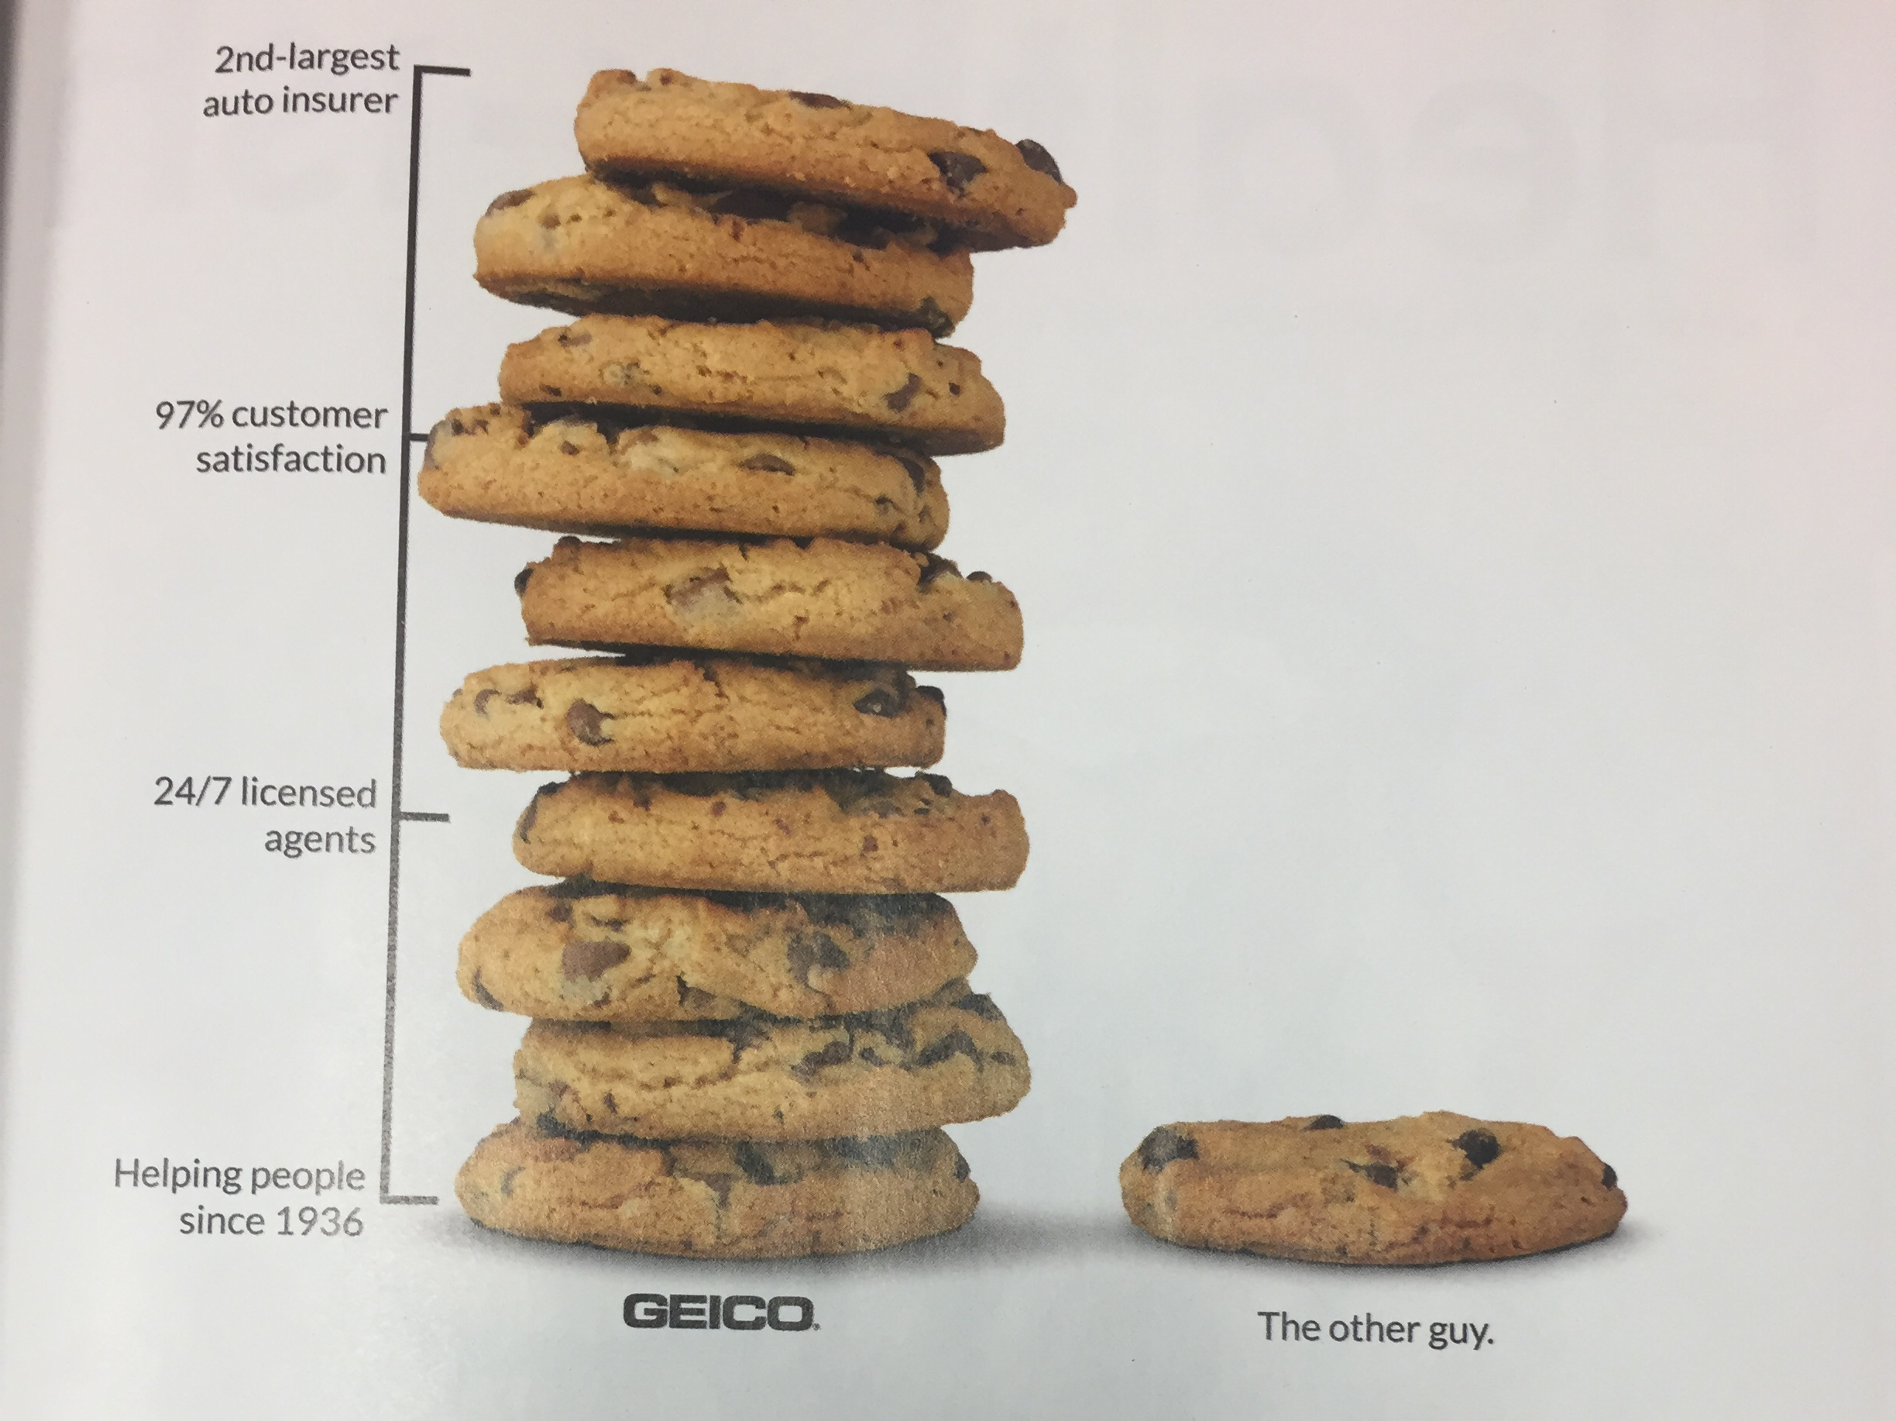
Wired, Jan 2017

Slide 4
D = 2.0, A = PI
D = 1.6, A = 0.65*PI
A Ratio = 0.65 (67%/43.5%)
D Ratio = 0.8 (67%/53.6%)
D = 1.7, A = 0.73*PI
D = 0.8, A = 0.16*PI
A Ratio = 0.21 (48%/10.1%)
D Ratio = 0.47 (48%/22.6%)
D = 1.05, A = 0.28*PI
D = 0.8, A = 0.16*PI
A Ratio = 0.57 (16%/9.1%)
D Ratio = 0.76 (16%/12.1%)
D = 0.5, A = 0.06*PI
D = 0.35, A = 0.03*PI
A Ratio = 0.5 (4%/2%)
D Ratio = 0.7 (4%/2.8%)
Wired, Jan 2017

Slide 5
analysis: what, why, and how
what is shown?
why is the user looking at it?
how is it shown?
abstract vocabulary avoids domain-specific terms
what-why-how analysis framework as scaffold to think systematically about design space

Slide 6
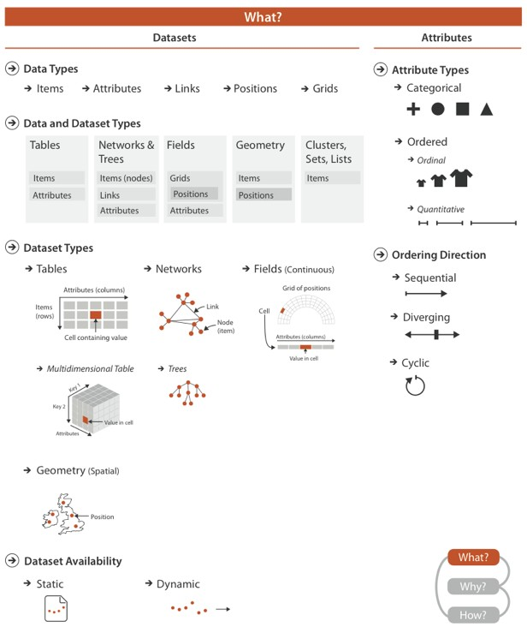
data abstraction

Slide 7
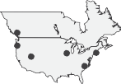
visual encoding
How?
Encode
Manipulate
Facet
Reduce
Arrange
Map
from categorical and ordered attributes
Change
Juxtapose
Filter
Express
Separate
Color
Order
Align
Hue Saturation Luminance
Select
Partition
Aggregate
Size, Angle, Curvature, ...
Use
Navigate
Superimpose
Embed
Shape
Motion
Direction, Rate, Frequency, ...

Slide 8
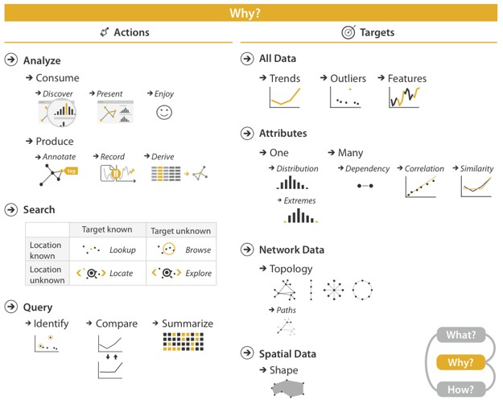
task abstraction

Slide 9
{action, target} pairs
discover distribution
compare trends
locate outliers
browse topology

Slide 10
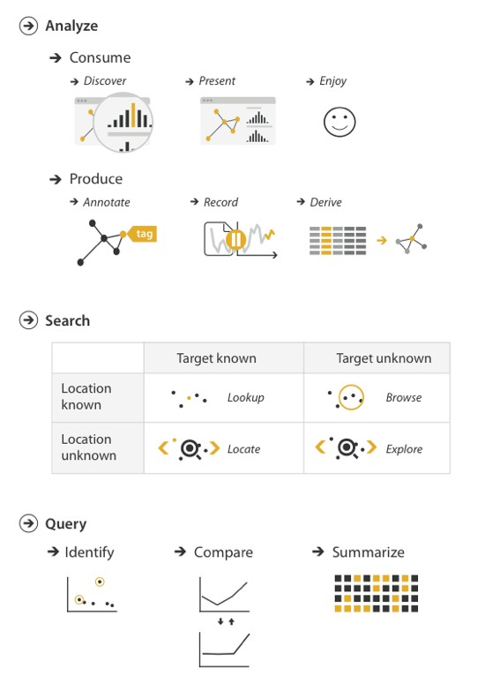
{action, target}

Slide 11
{action, target}

Slide 12

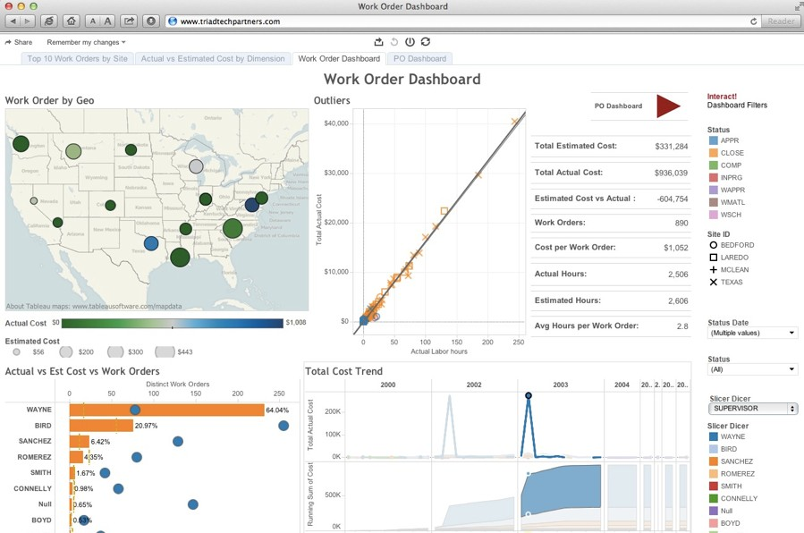
discover

Slide 13
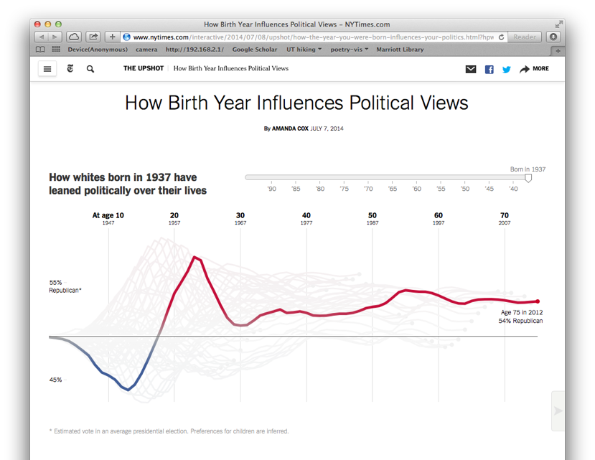
present
https://www.nytimes.com/interactive/2014/07/08/upshot/how-the-year-you-were-born-influences-your-politics.html

Slide 14
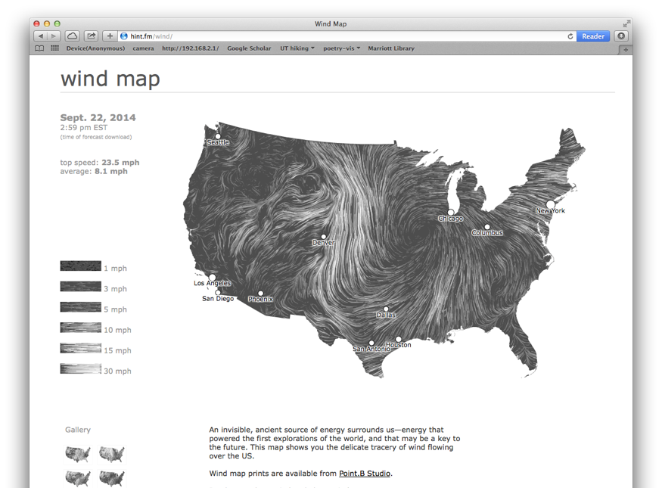
enjoy
http://hint.fm/wind/

Slide 15
{action, target}

Slide 16
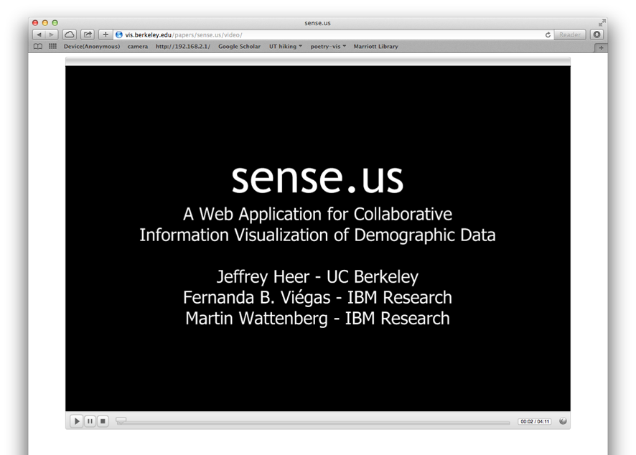
annotate & record
http://vis.stanford.edu/files/sense.us/

Slide 17
{action, target}

Slide 18
{action, target}

Slide 19
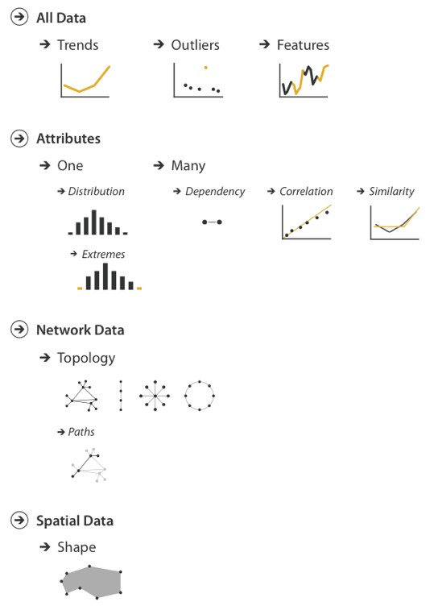
{action, target}

Slide 20
{action, target}

Slide 21
{action, target}

Slide 22
{action, target}

Slide 23
why does this matter?

Slide 24
A Design Space of Visualization Tasks
Hans-Jo¨ rg Schulz, Thomas Nocke, Magnus Heitzler, and Heidrun Schumann
Abstract—Knowledge about visualization tasks plays an important role in choosing or building suitable visual representations to pursue them. Yet, tasks are a multi-faceted concept and it is thus not surprising that the many existing task taxonomies and models all describe different aspects of tasks, depending on what these task descriptions aim to capture. This results in a clear need to bring these different aspects together under the common hood of a general design space of visualization tasks, which we propose in this paper. Our design space consists of five design dimensions that characterize the main aspects of tasks and that have so far been distributed across different task descriptions. We exemplify its concrete use by applying our design space in the domain of climate impact research. To this end, we propose interfaces to our design space for different user roles (developers, authors, and end users) that allow users of different levels of expertise to work with it.
Index Terms—Task taxonomy, design space, climate impact research, visualization recommendation
1 INTRODUCTION
As the field of information visualization matures, a phase of consoli- dation sets in that aims to pull together multiple individual works of research under a common conceptual hood. This hood can take on different shapes and forms, one of which is the design space. Such a design space realizes a descriptive generalization that permits to spec- ify a concrete instance – be it a layout [8], a visualization [46], or a combination of visualizations [28] – by making design choices along a number of independent design dimensions. Even last year’s InfoVis conference recognized the increasing importance of design spaces by dedicating an entire session to them.
Yet, information visualization is more than the visual representation alone. It also takes into account the tasks the user wishes to pursue with the visual representation. The literature contains a wealth of clas- sifications, taxonomies, and frameworks that describe these tasks: lists of verbal task descriptions, mathematical task models, domain-specific task collections, and procedural task combinations into workflows. All of these serve the respective purpose well for which they have been de- veloped. However, the research question of how to consolidate them under the hood of one common design space is still open, even though it has been shown on a smaller scale that such a combination into a common framework can be a useful endeavor [9, 21].
In this paper, we aim to give a first answer to this research ques- tion by contributing such a design space for visualization tasks. This contribution is twofold. First, it derives an abstract design space that brings together the different aspects of the existing task taxonomies and models. It serves to clarify the somewhat fuzzy notion of visual-
a visualization task design space for climate impact research based on structured interviews with eight domain experts and two visualization developers. This design space is then utilized to recommend visual- izations that are suitable to pursue a given task in that field.
The remainder of this paper is organized as follows: The related work is summarized in Section 2 and from its discussion, we derive our task design space in Section 3. We then debate its properties, lim- itations, and applications in Section 4. This also includes examples of how some of the existing task taxonomies can be expressed as parts of our design space. After this conceptual part, Section 5 details the use case example of how to apply the general design space to the ap- plication domain of climate impact research and how to draw concrete benefits from it. With this example, we aim to show a feasible way for the adaptation of the design space that can be transferred to other application domains as well. We conclude this paper by briefly shar- ing our personal experience from working with the design space and pointing out directions for future work in Section 6.
2 RELATED WORK
The concept of tasks exhibits numerous facets that are also reflected in the existing body of research on that topic. Commonly, visualization tasks are understood as activities to be carried out interactively on a visual data representation for a particular reason. The investigation of visualization tasks has the aim to establish recurring tasks in order to use the knowledge about them for improving the design and evalu- ation of visualizations. Existing research for both of these aspects is

Slide 25
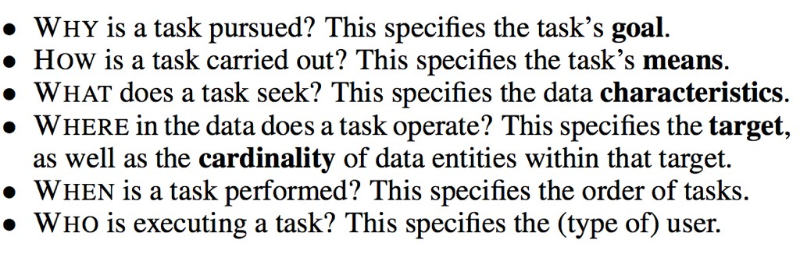
A Design Space of Visualization Tasks
Hans-Jo¨ rg Schulz, Thomas Nocke, Magnus Heitzler, and Heidrun Schumann
Abstract—Knowledge about visualization tasks plays an important role in choosing or building suitable visual representations to pursue them. Yet, tasks are a multi-faceted concept and it is thus not surprising that the many existing task taxonomies and models all describe different aspects of tasks, depending on what these task descriptions aim to capture. This results in a clear need to bring these different aspects together under the common hood of a general design space of visualization tasks, which we propose in this paper. Our design space consists of five design dimensions that characterize the main aspects of tasks and that have so far been distributed across different task descriptions. We exemplify its concrete use by applying our design space in the domain of climate impact research. To this end, we propose interfaces to our design space for different user roles (developers, authors, and end users) that allow users of different levels of expertise to work with it.
Index Terms—Task taxonomy, design space, climate impact research, visualization recommendation
1 INTRODUCTION
As the field of information visualization matures, a phase of consoli- dation sets in that aims to pull together multiple individual works of
a visualization task design space for climate impact research based on structured interviews with eight domain experts and two visualization
research under a common conceptual hood. This hood can take on developers. This design space is then utilized to recommend visual- different shapes and forms, one of which is the design space. Such a izations that are suitable to pursue a given task in that field.
design space realizes a descriptive generalization that permits to spec- The remainder of this paper is organized as follows: The related ify a concrete instance – be it a layout [8], a visualization [46], or a work is summarized in Section 2 and from its discussion, we derive combination of visualizations [28] – by making design choices along our task design space in Section 3. We then debate its properties, lim- a number of independent design dimensions. Even last year’s InfoVis itations, and applications in Section 4. This also includes examples of conference recognized the increasing importance of design spaces by how some of the existing task taxonomies can be expressed as parts dedicating an entire session to them. of our design space. After this conceptual part, Section 5 details the
Yet, information visualization is more than the visual representation use case example of how to apply the general design space to the ap- alone. It also takes into account the tasks the user wishes to pursue plication domain of climate impact research and how to draw concrete
with the visual representation. The literature contains a wealth of clas- benefits from it. With this example, we aim to show a feasible way sifications, taxonomies, and frameworks that describe these tasks: lists for the adaptation of the design space that can be transferred to other of verbal task descriptions, mathematical task models, domain-specific application domains as well. We conclude this paper by briefly shar- task collections, and procedural task combinations into workflows. All ing our personal experience from working with the design space and of these serve the respective purpose well for which they have been de- pointing out directions for future work in Section 6.
veloped. However, the research question of how to consolidate them
under the hood of one common design space is still open, even though ^{2 RELATED WORK}
it has been shown on a smaller scale that such a combination into a The concept of tasks exhibits numerous facets that are also reflected in common framework can be a useful endeavor [9, 21]. the existing body of research on that topic. Commonly, visualization In this paper, we aim to give a first answer to this research ques- tasks are understood as activities to be carried out interactively on a tion by contributing such a design space for visualization tasks. This visual data representation for a particular reason. The investigation of contribution is twofold. First, it derives an abstract design space that visualization tasks has the aim to establish recurring tasks in order
brings together the different aspects of the existing task taxonomies
to use the knowledge about them for improving the design and evalu-
and models. It serves to clarify the somewhat fuzzy notion of visual-
ation of visualizations. Existing research for both of these aspects is

Slide 26
Using Interaction
Change Over Time
Rearranging
Selection & Highlighting
Linking
Filtering
Navigation

Slide 27
CHANGE OVER TIME

Slide 28
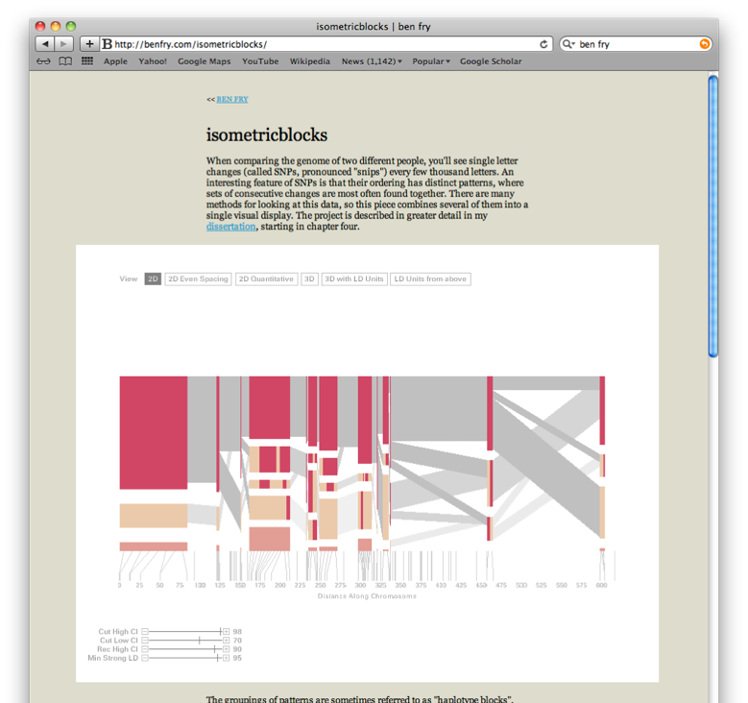
animated transitions
http://benfry.com/isometricblocks/

Slide 29
Rearranging

Slide 30
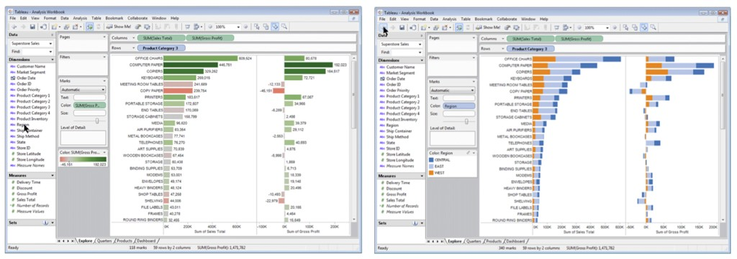
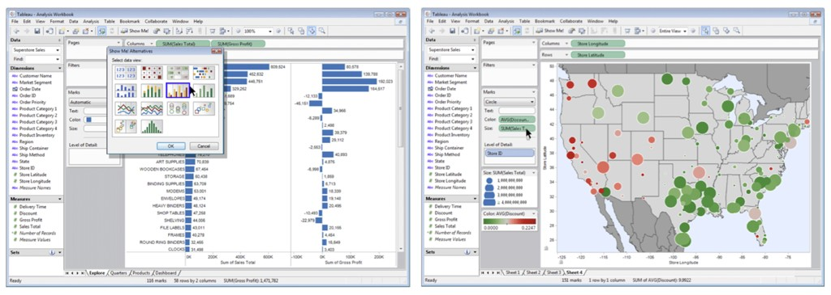
change encoding

Slide 34
SELECTION & HIGHLIGHTING

Slide 35
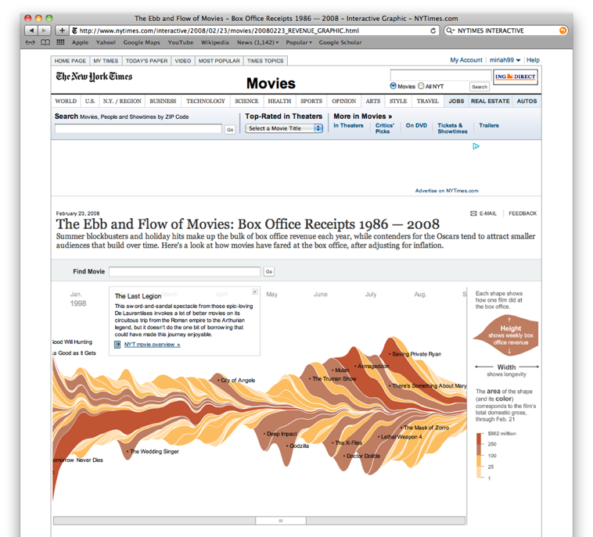
http://www.nytimes.com/interactive/2008/02/23/movies/20080223_REVENUE_GRAPHIC.html

Slide 36
Linking

Slide 37
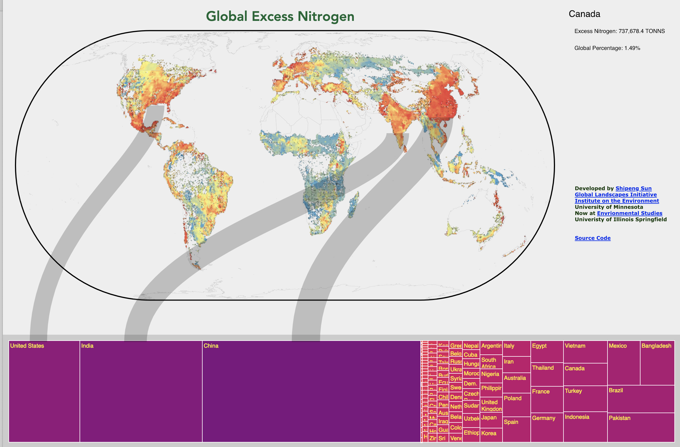
http://sunsp.net/demo/GeogTreeMaps/

Slide 38
Filtering

Slide 39
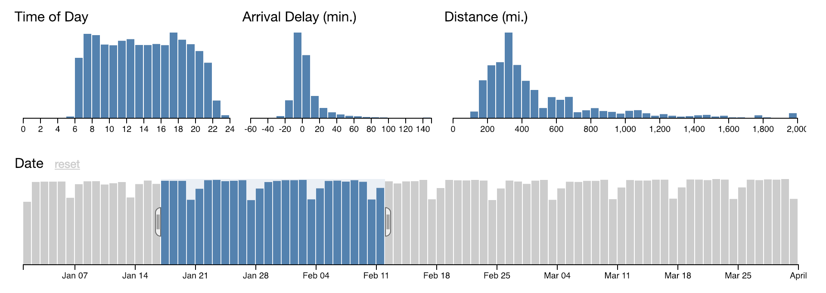
http://square.github.io/crossfilter/

Slide 40
NAVIGATION

Slide 41
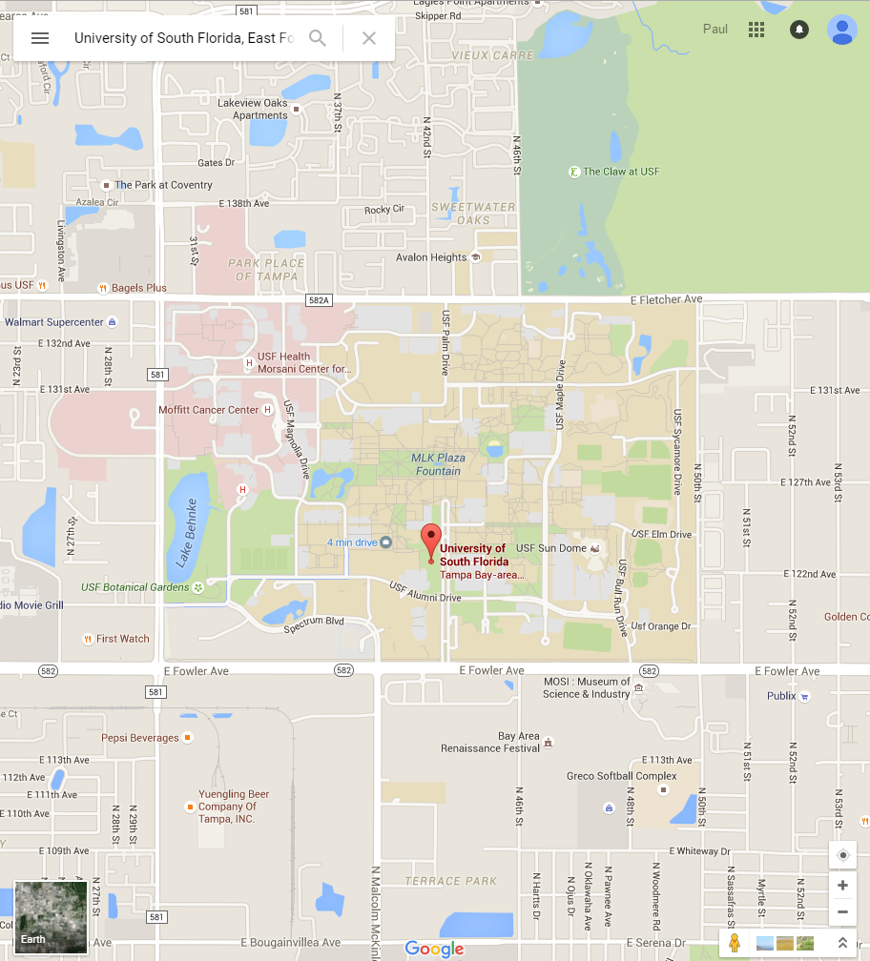
pan (and translate)

Slide 42
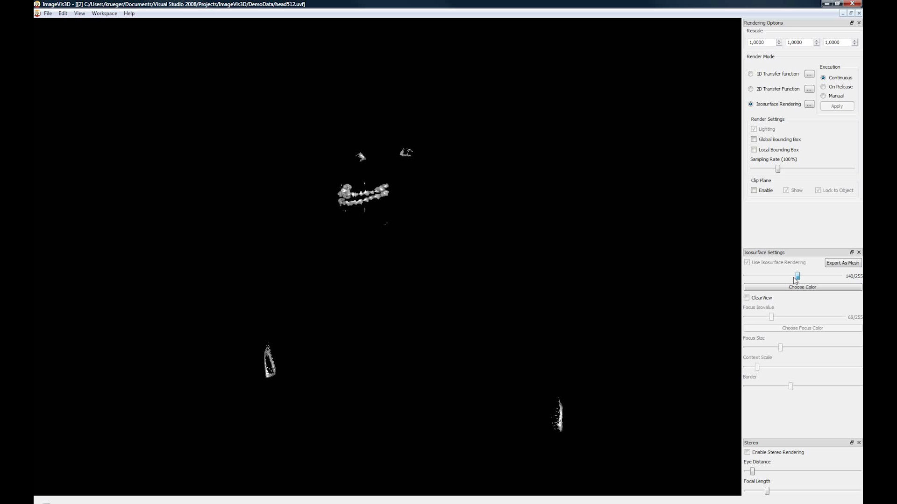
rotate

Slide 43
GEOMETRIC vs SEMANTIC ZOOMING

Slide 44

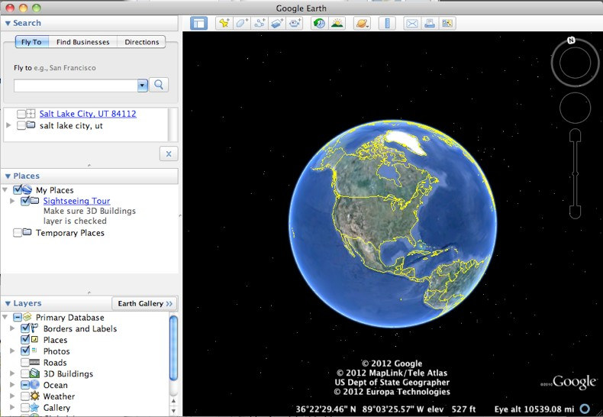
geometric

Slide 45

semantic

Slide 46
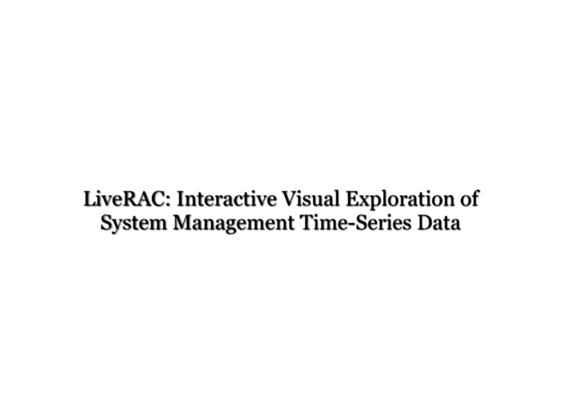
semantic

Slide 47
Recommended Reading
Visualization Analysis & Design: Chapter 3 (pp. 42-65)

